Slide 1


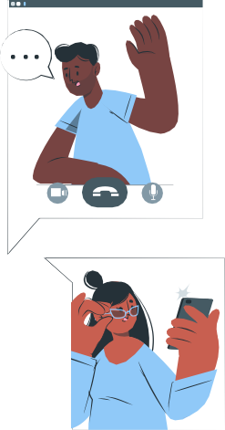



XYZ SCHOOL
Network Forensic Report
– PCAP Network Packet Capture Analysis
Presented by: Sanithu Methnuka & Laseya Wimalasiri

Slide 2



Executive Summary
Investigation into harassing emails sent to Professor Lily Tuckrige.
Emails were sent via anonymous services and linked to a dorm’s unprotected Ethernet connection.
Methods used: Browser fingerprinting, TCP flow analysis, packet sniffing.
Goal: Identify the sender through network forensic techniques.

Slide 3




Investigative Approach:
Step 1: Analysis of email metadata.
Step 2: Tracking network activity for suspicious behavior.
Step 3: Identifying devices using MAC addresses.
Step 4: Cross-referencing Chemistry 109 student records with network logs.

Slide 4




Network Capture File Details
Capture Length: 56 MB
Format: Wireshark (.pcap)
Packet Size Limit: 4096 bytes
Total Time Captured: 4 hours, 22 minutes
Packet Analysis Tools Used: Wireshark v4.4.2

Slide 5





Identified Network Components
Key Devices : Apple Device
: (MAC: 00:17:f2:e2:c0:ce)
: IP: 192.168.15.4
Router (HonHaiPrecis) – IP: 192.168.1.254
Suspicious Network Activity: Multiple connections to willselfdestruct.com and sendanonymous mail.net.

Slide 6
Associating a Suspect with Network
Dormitory IP Address: 140.247.62.34
MAC Address Tracking: Apple device repeatedly accessed anonymous email services.
Cross-referencing with Student
Data: Activity linked to Chemistry 109 student Johnny Coach.

Slide 7




Forensic Methodology
Email Header Analysis - (Identified source IP)
Network Packet Capture (PCAP) - (Tracked HTTP/DNS queries)
MAC Address Identification - (Mapped devices to activity)
User Behavior Mapping - (Cross-referenced student logs)

Slide 8



Key Findings
Sender’s IP Address:
140.247.62.34
Device Used:
Anonymous Services Used:
Apple(MAC00:17:f2:e2:c0:ce)
willselfdestruct.com
sendnonymousmail.net
Activity Timeline:
Correlated timestamps with email-sending events.

Slide 9
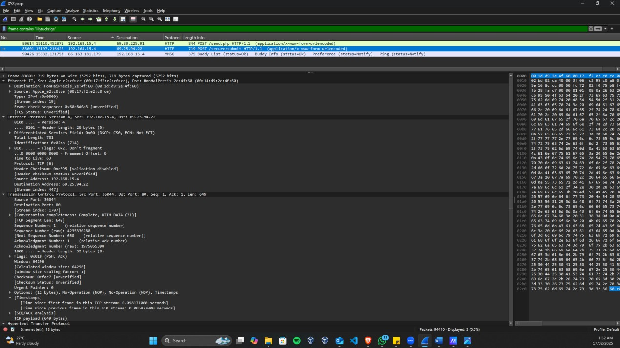
Key Findings (Lilytuckrige)

Slide 10
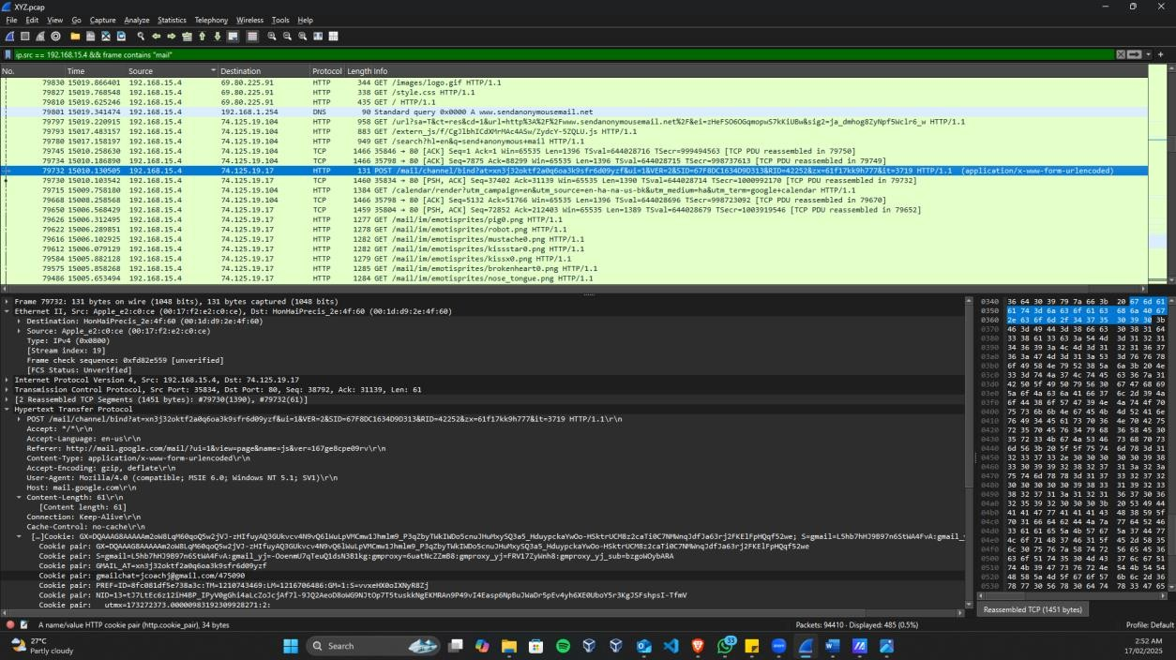
Key Findings (Suspect Details)

Slide 11
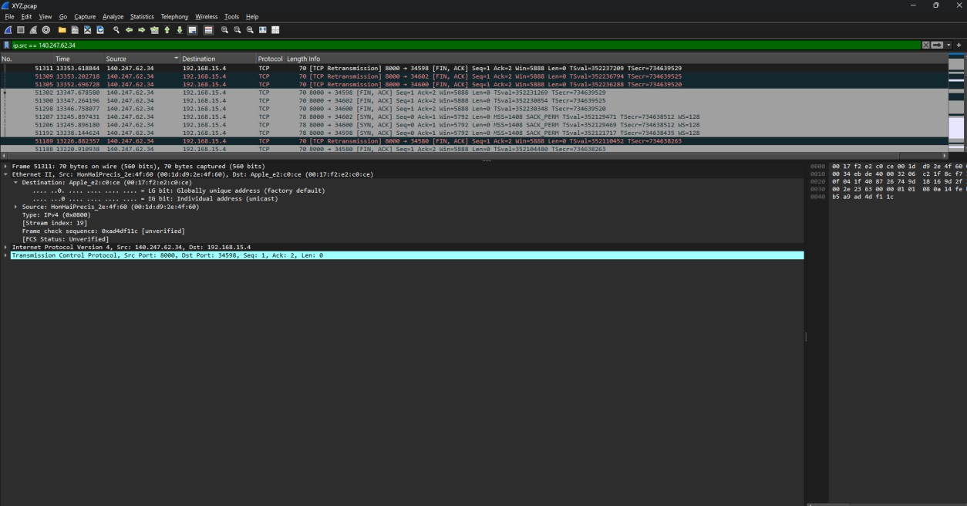
Key Findings (Dorm Room)

Slide 12
Key Findings

Slide 13
Supporting Evidence
Captured Packets:
HTTP & YMSG traffic logs.
Wireshark
Analysis:
Identified packets
containing “lilytuckrige”
(victim’s name)..
Packet Metadata:
Timestamps matched email transmission
times.

Slide 14



Activity Timeline
Packet No. | Activity | Destination
79780 | Google Search: “Send Anonymous Mail” | google.com
80614 | Email Sent via SendAnonymousMail.net | 69.80.225.91
82912 | Accessed WillSelfDestruct.com | 69.25.94.22
83601 | Sent Another Email via WillSelfDestruct | 69.25.94.22

Slide 15



Challenges & Limitations
Unsecured Wi-Fi – Hard to pinpoint a single user.
Anonymous Email Services – Designed to erase digital traces.
Privacy Restrictions – No access to personal devices.

Slide 16
Conclusion
The investigation successfully linked network
activity to a suspect.
The harassing emails were sent using
anonymous services.
Forensic techniques like MAC tracking, PCAP analysis, and student records helped establish evidence.
Further administrative/judicial actions are
required.

Slide 17


Recommendations
Strengthen dormitory network security.
Enforce policies against unauthorized routers.
Increase awareness of anonymous email abuse.
Conduct regular forensic network monitoring.

Slide 18





Thank You!!

